Slide 1
Data Structure & Algorithm
Lecture 1: Overview
Dr. Mohamed Ezz
Al-Azhar University

Slide 2
Textbook
Data Structures & Algorithms in Java, by Robert Lafore
Data Structures Succinctly Part 1,2, by Robert Horvick.
  Free for download from Syncfusion.com
Lectures Website:
http://classjump.com/e/ezz/?what=classes&class=192385

Slide 3
Schedule and Arrangement
Lectures
  FOR N= 1 to 5
      If N Odd then Increment Week by two lectures
      If N Even then Increment Week by one lecture
  End For
1 Class Weekly
  Bring your laptop

Slide 4
Participation
You are expected to attend all of the lectures
  Exams will be based on the lectures materials
  More than four absent will not attend final exam
Group Activities
  Very Important
Team Project
  Select your project as early as possible
    Website contain sample projects
  Group of max.10 students

Slide 5
Assignments and Quizzes
Must be submitted on time
Late assignments will be accepted within one week with -25% penalties
Lecture example/programs should be solved same day on your computer → This prerequisite fro attend class
All sheets questions must be solved by student → please come ready
Bonus points for first 5 student solve quiz in the class

Slide 6

Why you want to study Algorithms?
Making a lot of money out of a great algorithm…
Founders Larry Page and Sergey Brin met at Stanford University in 1995. By 1996, they had built a search engine (initially called BackRub) that used links to determine the importance of individual webpages.

Slide 7
Why you want to study Algorithms?
How Facebook, Gmail, Yahoo store our account?
Using Database Tables as shown:
Store Data
Sort Data
Search
ID | Name | Email | phone
1 | Tamer | tr@gmail.com | 0101052474
2 | Mustafa | ms@gmail.com | 0125544775
3 | Kamel | km@gmail.com | 0115554422
4 | Noha | nh@gmail.com | 0102225544
..
2,000,000,000
The base for Database is Data Structure & Algorithm

Slide 8
Objectives
Learn basic data structures and algorithms
  data structures – how data is organized
  algorithms – unambiguous sequence of steps to compute something
  algorithm analysis – determining how long an algorithm will take to solve a problem
Become a better software developer
  "Data Structures + Algorithms = Programs"
  -- Niklaus Wirth, author of Pascal language

Slide 9
Course Topics
Store Data: Array, Lists, Stacks, Queues
Sorting Data: Sort Algorithms
Search for Data : Search Algorithms and Trees
Algorithm Analysis: good or bad algorithm

Slide 10
1-Storing Data
Lists
Graphs
Trees

Slide 11
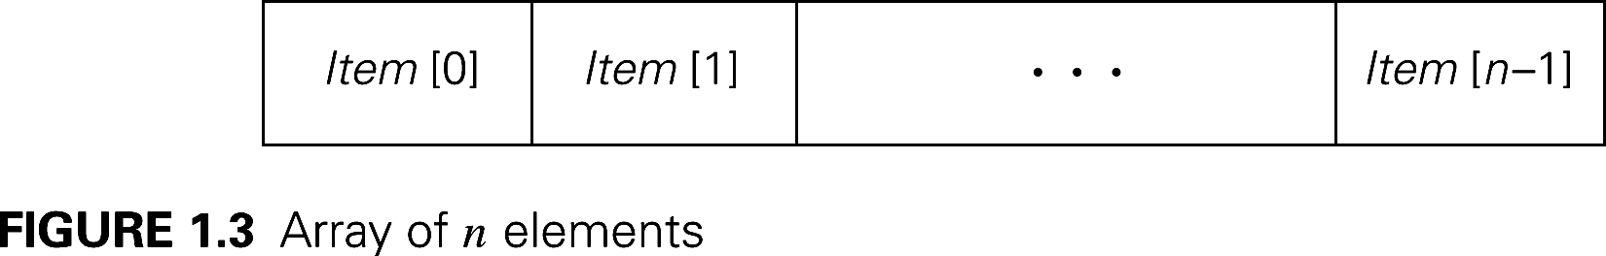
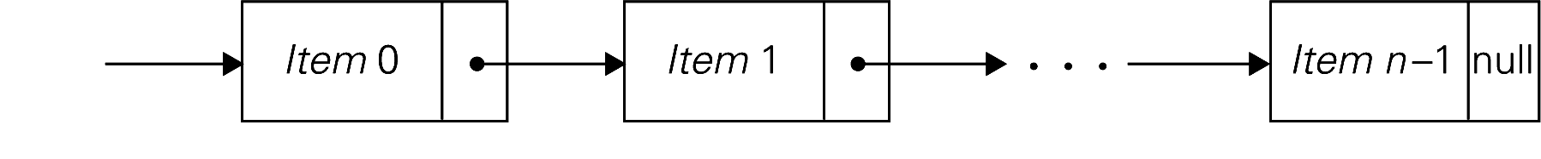
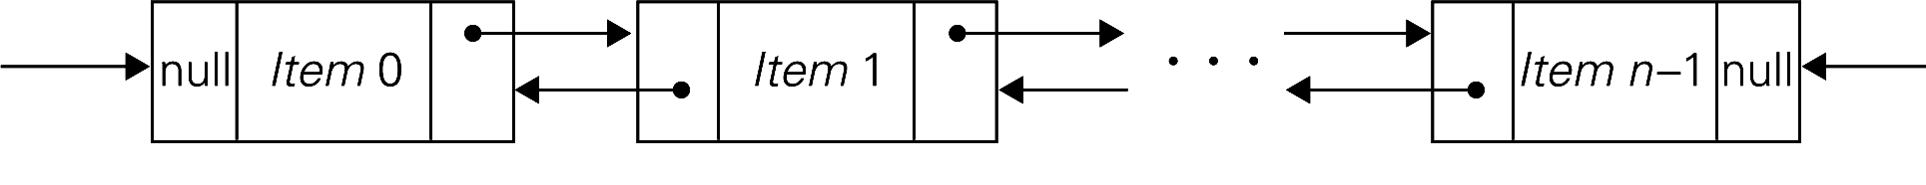
Linear Data Structures
Array of n elements
Singly linked list of n elements
Double linked list of n elements

Slide 12
Linear Data Structures
Arrays
  A sequence of n items of the same data type that are stored contiguously in computer memory and made accessible by specifying a value of the array’s index.
Linked List
  A sequence of zero or more nodes each containing two kinds of information: some data and one or more links called pointers to other nodes of the linked list.
    Singly linked list (next pointer)
    Doubly linked list (next + previous pointers)
Arrays
  fixed length (need preliminary reservation of memory)
  contiguous memory locations
  direct access
  Insert/delete
Linked Lists
  dynamic length
  arbitrary memory locations
  access by following links
  Insert/delete
12

Slide 13
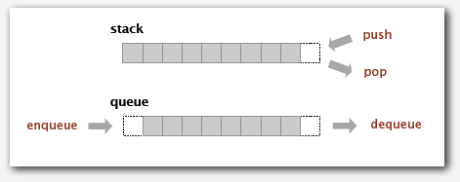
Stacks, Queues

Slide 14
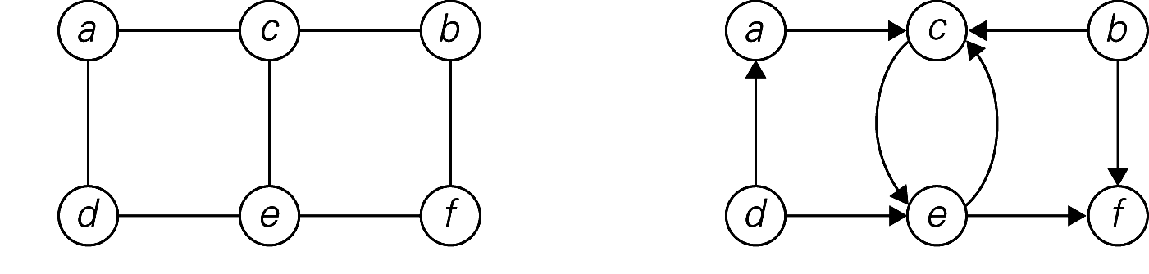
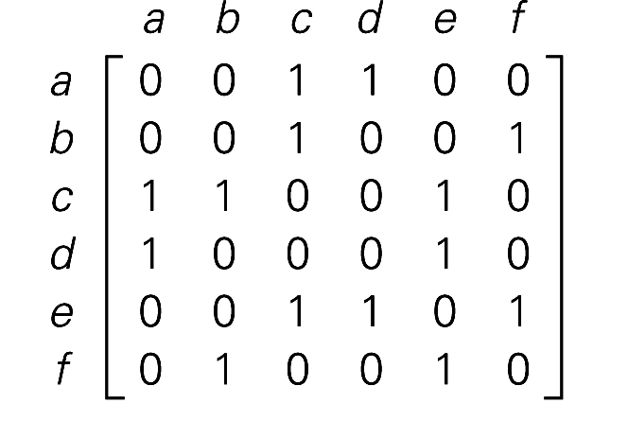
Graphs
A graph G = <V, E> is defined by a pair of two sets: a finite set V of items called vertices and a set E of vertex pairs called edges.
Undirected and directed graphs (digraph).
(a)
(b)

Slide 15
2-Sorting Data
Rearrange the items of a given list in ascending/descending order.
  Input: A sequence of n numbers <a₁, a₂, …, a_{n}>
  Output: A reordering <a´₁, a´₂, …, a´_{n}> of the input sequence such that a´₁≤ a´₂ ≤ … ≤ a´_{n.}
Why sorting?
  Help searching
  Algorithms often use sorting as a key subroutine.
Sorting key
  A specially chosen piece of information used to guide sorting. I.e., sort student records by names.

Slide 16
Sorting
Examples of sorting algorithms
  Bubble sort
  Selection sort
  Insertion sort
  Merge sort
  Quick sort
Evaluate sorting algorithm complexity: the number of key comparisons.
Sort the following :
  3,1,7,3,2,9,6,5
  f,s,h,e,c,h,y,s
  Mohamed, Ahmed, Manal, Karema

Slide 17
3-Searching for data
Find a given value, called a search key, in a given set.
Examples of searching algorithms
  Sequential searching
  Binary searching…
What is Hamza Age? Search for Hamza
Ahmed | Amal | Basma | Dina | Hamza | Kareem | Kamel | Mohamed | Nadia
18 | 19 | 17 | 18 | 17 | 18 | 19 | 20 | 18

Slide 18
Other algorithm problems
Combinatorial problems
  Find a combinatorial object: permutation, combination, subset that satisfies constraints and objectives
Geometric problems
  Closest-pair problem: given n points in the plane, find the closest pair (Data mining - cluster)
Numerical problems
  Solving equations

Slide 19
4-Algorithm Analysis: Why?
Correctness:
  Does the algorithm do what is intended.
Performance:
  What is the running time of the algorithm.
  How much storage does it consume.
Different algorithms may correctly solve a given task
  Which should I use?

Slide 20
Measuring Performance: Empirical Approach
Implement it, run it, time it (averaging trials)
  Pros?
    No math!
  Cons?
    Need to implement code
    When comparing two algorithms, all other factors need to be held constant (e.g., same computer, OS, processor, load)
    A really bad algorithm could take a really long time to execute

Slide 21
Measuring Performance: Analytical Approach
Use a simple model for basic operation costs
Computational Model
  has all the basic operations:
  +, -, *, / , =, comparisons
  infinite memory
  all basic operations take exactly one time T unit to execute
Notes:
analysis = determining run-time efficiency.
model = estimate, not meant to represent everything in real-world

Slide 22
Measuring Performance: Analytical Approach
Analyze steps of algorithm, estimating amount of work each step takes
  Pros?
    Independent of system-specific configuration
    Good for estimating
    Don't need to implement code
  Cons?
    Won't give you info exact runtimes optimizations made by the computer architecture
    Only gives useful information for large problem sizes
    In real life, not all operations take exactly the same time (multiplication takes longer than addition) and have memory limitations

Slide 23
Analyzing Performance
General “rules” to help measure how long it takes to do things:
Basic operations
Consecutive statements
Conditionals
Loops
Function calls
Recursive functions
Constant time
Sum of number of statements
Test, plus larger branch cost
Sum of iterations
Cost of function body
Solve “recurrence relation”

Slide 24
Efficiency examples
statement1;
statement2;
statement3;
for (int i = 1; i <= N; i++) {
statement4;
}
for (int i = 1; i <= N; i++) {
statement5;
statement6;
statement7;
}
3
N
4N + 3
3N

Slide 25
Efficiency examples 2
for (int i = 1; i <= N; i++) {
for (int j = 1; j <= N; j++) {
statement1;
}
}
for (int i = 1; i <= N; i++) {
statement2;
statement3;
statement4;
statement5;
}
How many statements will execute if N = 10? If N = 1000?
N²
N² + 4N
4N

Slide 26
Relative rates of growth
Most algorithms' runtime can be expressed as a function of the input size N
rate of growth: measure of how quickly the graph of a function rises
Goal: distinguish between fast- and slow-growing functions
  We only care about very large input sizes (for small sizes, almost any algorithm is fast enough)
  This helps us discover which algorithms will run more quickly or slowly, for large input sizes
Most of the time interested in worst case performance; sometimes look at best or average performance

Slide 27
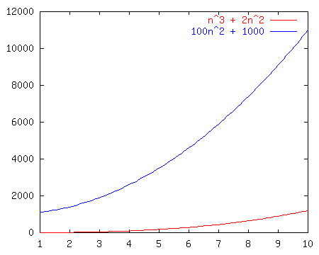
Growth rate example
Consider these graphs of functions.
Perhaps each one represents an algorithm:
n³ + 2n²
100n² + 1000
Which grows faster?

Slide 28
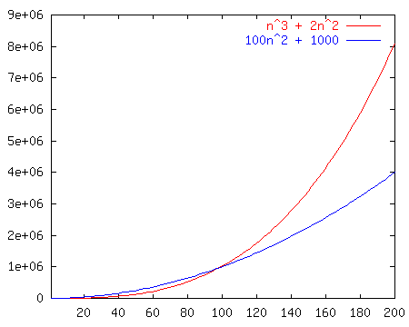
Growth rate example
How about now?

Slide 29
Homework
  Implement the following program
  Test this program with Measuring Performance: using Empirical and Analytical
  Test Encryption using key 123, decryption using 132
  public class EncryptXOR {
  public static String xorEnc(int encKey, String toEnc) {
  String tog = "";
  for (int i = 0; i < toEnc.length(); i++) {
  int a = toEnc.charAt(i);
  int c = a ^ encKey;
  char d = (char) c;
  tog = tog + d;
  }
  return tog;
  }
  public static void main(String[] arg) {
  String s = xorEnc(123, "1234567890");
  System.out.println("enc:" + s);
  s = xorEnc(123, s);
  System.out.println("dec:" + s);
  }
  }

